Slide 1



Bridging the Gap: Automated Military Competency Extraction
An LLM-Enhanced Pipeline for AFSC Skill Analysis
Kyle Hall
Data Science Capstone | Fall 2025
The George Washington University

Slide 2
Background
~$850B+
1.3M
200K
2.8%
FY25 DoD Budget
Active-Duty Service Members
Service Members Transition Annually
Veteran Unemployment (2023)
GAO-24-107752 (2024): DoD/VA do not consistently measure transition outcomes (job quality, sustainment, credential attainment).
DoL Pilot Studies: Military training often lacks direct civilian credential equivalents despite substantial transferable value.
Skills Translation Gap: No authoritative, machine-readable taxonomy linking military competencies to civilian frameworks
Fragmented Specialty Systems: AFSC / MOS / NEC aren’t machine-aligned to ESCO/O*NET → large but under-used translatable potential
Notes:
Sources: DoD TAP, BLS Veterans Employment 2023, GAO-24-107752, DoL VETS
Government Accountability Office
Department of Labor

Slide 3

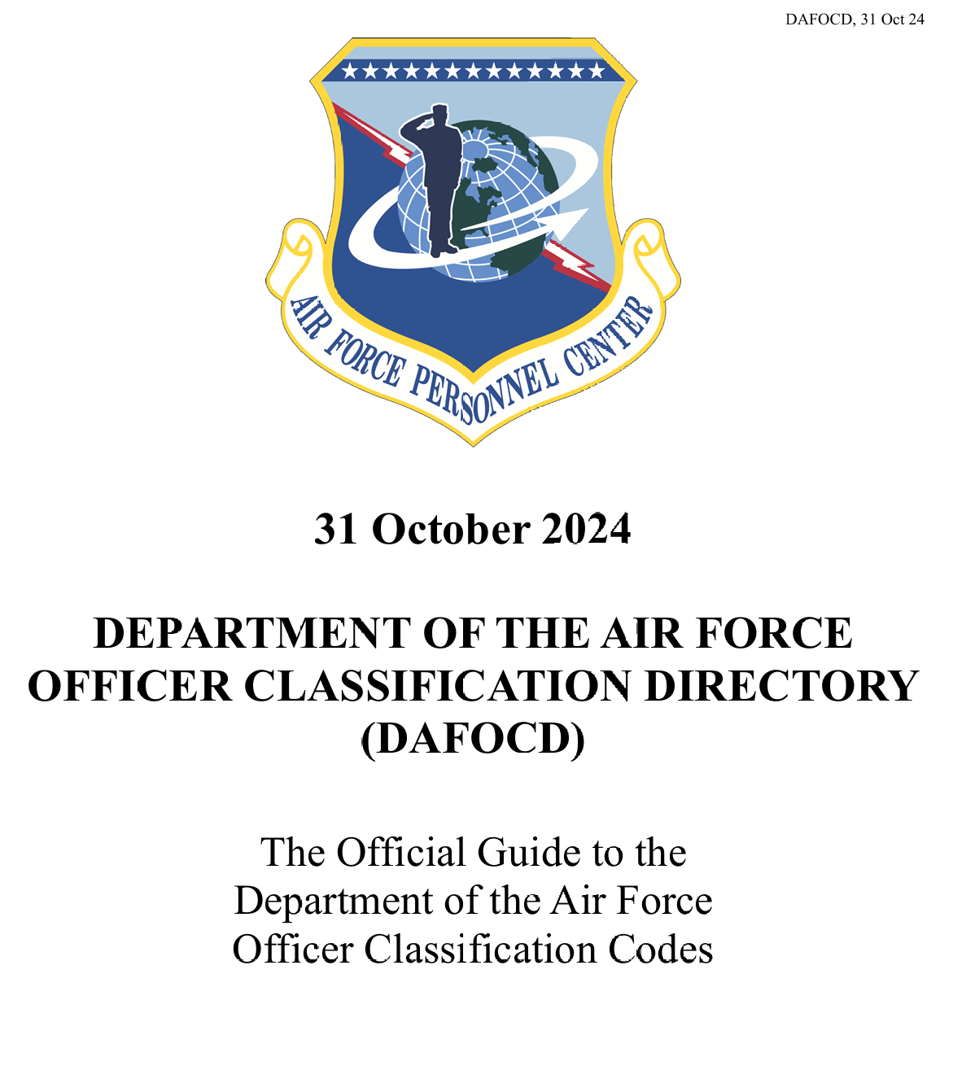
The Problem
v
1
Unstructured PDF Documents
AFSC competencies buried in 300+ page AFOCD/AFECD manuals with inconsistent formatting
2
No Cross-AFSC Queries
Cannot systematically compare competencies across specialties or identify transferable skills
3
Translation Friction
200K annual transitions but no automated link to civilian frameworks (ESCO, O*NET)
4
No Machine-Readable Output
Skills exist only as narrative prose, not structured data for workforce systems
5
Manual Process Doesn't Scale
300+ AFSCs would require SME review for each; no automation exists today

Slide 4
Goal and Scope
Objective: Automate the transformation of AFSC narrative text into structured KSAs
Structured
Aligned
Queryable
Machine-readable KSA items with confidence scores
ESCO taxonomy links for civilian translation
Neo4j graph for overlap analysis
Scope:
Deliverables:
12 AFSCs across three career fields:
End-to-end Python pipeline
Intelligence (4) | Operations (4) | Maintenance (4)
Neo4j graph database (347 nodes, 735 relationships)
4% sample of 300+ total AFSCs
Streamlit web app (demo, explore, admin modes)

Slide 5
Pipeline Architecture
PDF → Preprocess → Extract → Enhance → Filter → Dedupe → Graph → App
EXTRACT
ENHANCE
FILTER
LAiSER
Multi-LLM
Quality
Top 25 skills per AFSC
4 providers (OpenAI, Anthropic, Gemini, HF/Llama)
8-200 character limits
Built-in ESCO codes
+6 Knowledge, +6 Abilities per AFSC
Banned phrase removal
DEDUPE
PERSIST
PERFORMANCE
Fuzzy Match
Neo4j
Timing
0.86 similarity threshold
347 nodes, 735 relationships
60-80s base extraction
Jaccard + difflib hybrid
Idempotent MERGE writes
90-104s with LLM enhancement
APPLICATION
Streamlit Web App
5 pages: Home | Try It Yourself | Explore KSAs | Admin Tools | Documentation
Live demo mode | CSV export | Real-time metrics

Slide 6
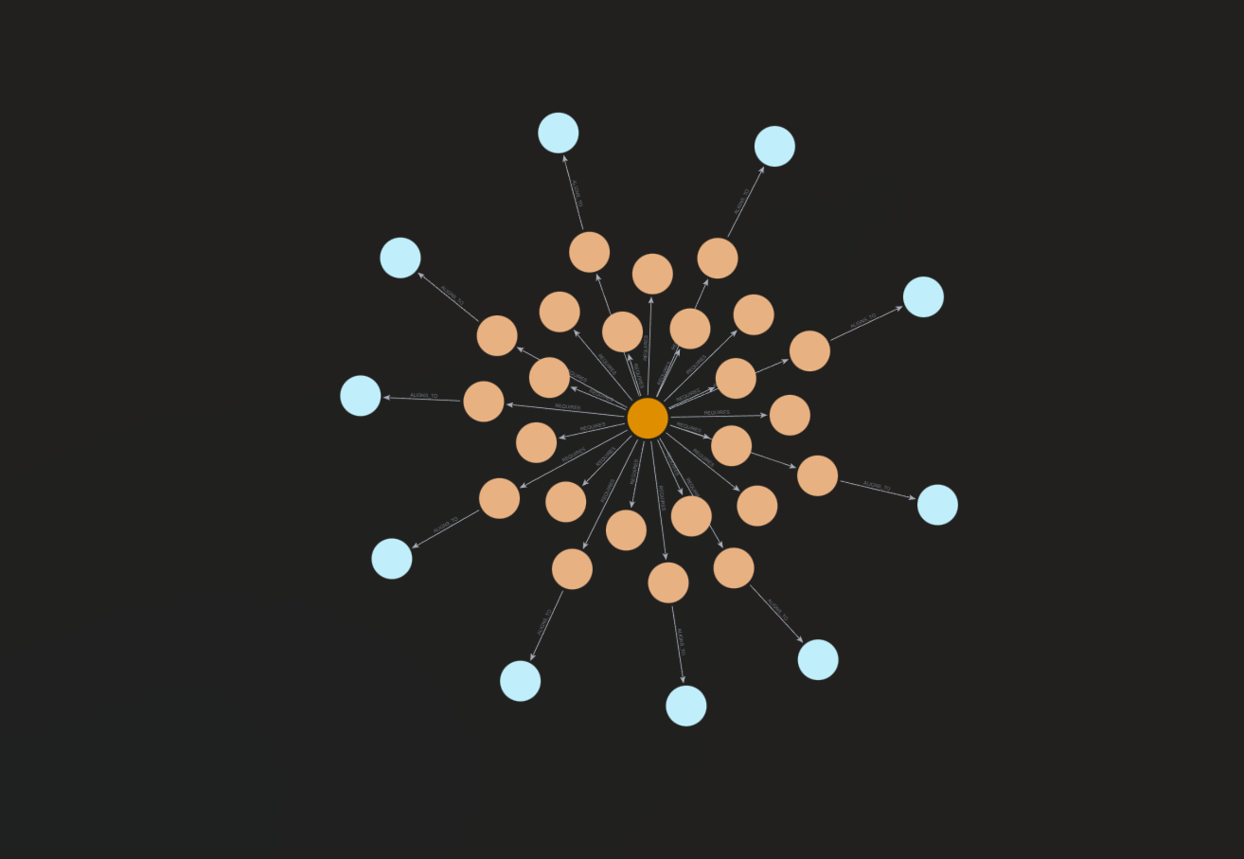
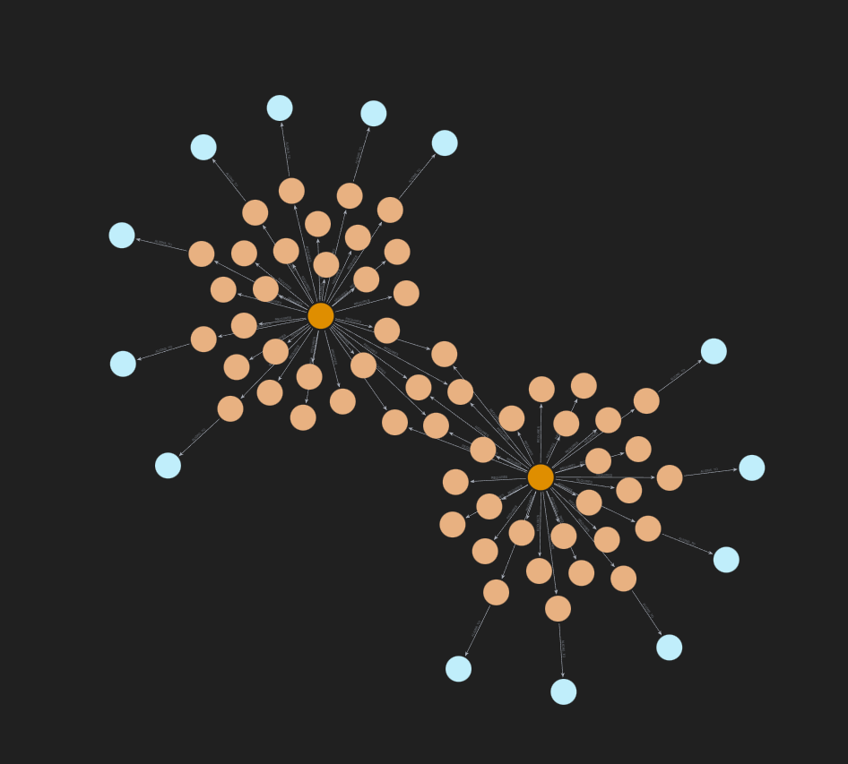
Graph Model
1N4 Cyber Intelligence AFSC
Intel Officer (14N) and Intel Operations (1N0)
347 / 735
Nodes / Relationships
79
Cross-AFSC Skill Overlaps
Nodes: AFSC, KSA, ESCOSkill, SourceDoc
Rels: REQUIRES, ALIGNS_TO, EXTRACTED_FROM

Slide 7
Key Results
253
79
18.2%
Unique KSAs
Cross-AFSC Overlaps
ESCO Aligned (46)
332 raw instances → 253 unique KSAs → 24% deduplication
KSA Type Distribution
Skills
189 (74.7%)
Knowledge
35 (13.8%)
Abilities
29 (11.5%)

Slide 8
Live Demo
A
B
C
Explore the App
Process
Results
Quick exploration of the Streamlit app and its functionality
17D Cyber Intel KSAs with taxonomy codes
Quick extraction run with live API showing the results

Slide 9
Impact and Limitations
Impact
Limitations and Next Steps
For TAP / SkillBridge
4% sample — Scale to all 300+ AFSCs
Surface transferable skills for resume translation and job matching
18.2% taxonomy — Expand ESCO + add O*NET alignment
For Gap Analysis
Identify where credentialing bridges military to civilian requirements
No SME validation — Build evaluation set with experts
For Analysts
Rapid overlap queries + CSV export for workforce planning
LLM variability — Different LLMs, different results; add caching and QC
Air Force only — Expand to NEC (Navy), MOS (Army/Marines)

Slide 10
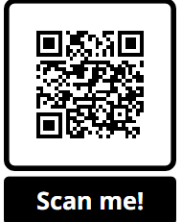
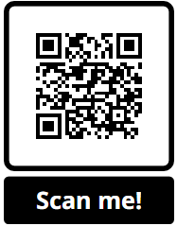
Questions?
THANK YOU!
Kyle Hall
GWU Data Science | Fall 2025
Live App
GitHub
App: https://fall-2025-group6-4w9txe2nuc2gn5h5ymtwbk.streamlit.app/
Repo: https://github.com/Kyleinexile/fall-2025-group6
Contact: kyle.hall@gwu.edu

